Slide 1
Portlaoise A National Demonstration Project
John Mulholland
Laois County Council

Slide 2
Why Portlaoise ?
Town has experienced rapid growth in past 15 years (> 80%), now over 22,000
High % of people under 35 yrs....54% (nat avge 47%)
Evidence of “doughnut effect” in town centre, pop decline, vacant and derelict sites, challenging trading environment
Significant outward migration of workers (11,500 daily)
Reflective of outer archipelago of Towns like Navan, Mullingar, Tullamore, Carlow etc.
Pressing need for intervention to bring cohesion to large residential estates (tenure management, community supports, training)
Integration of new communities

Slide 3
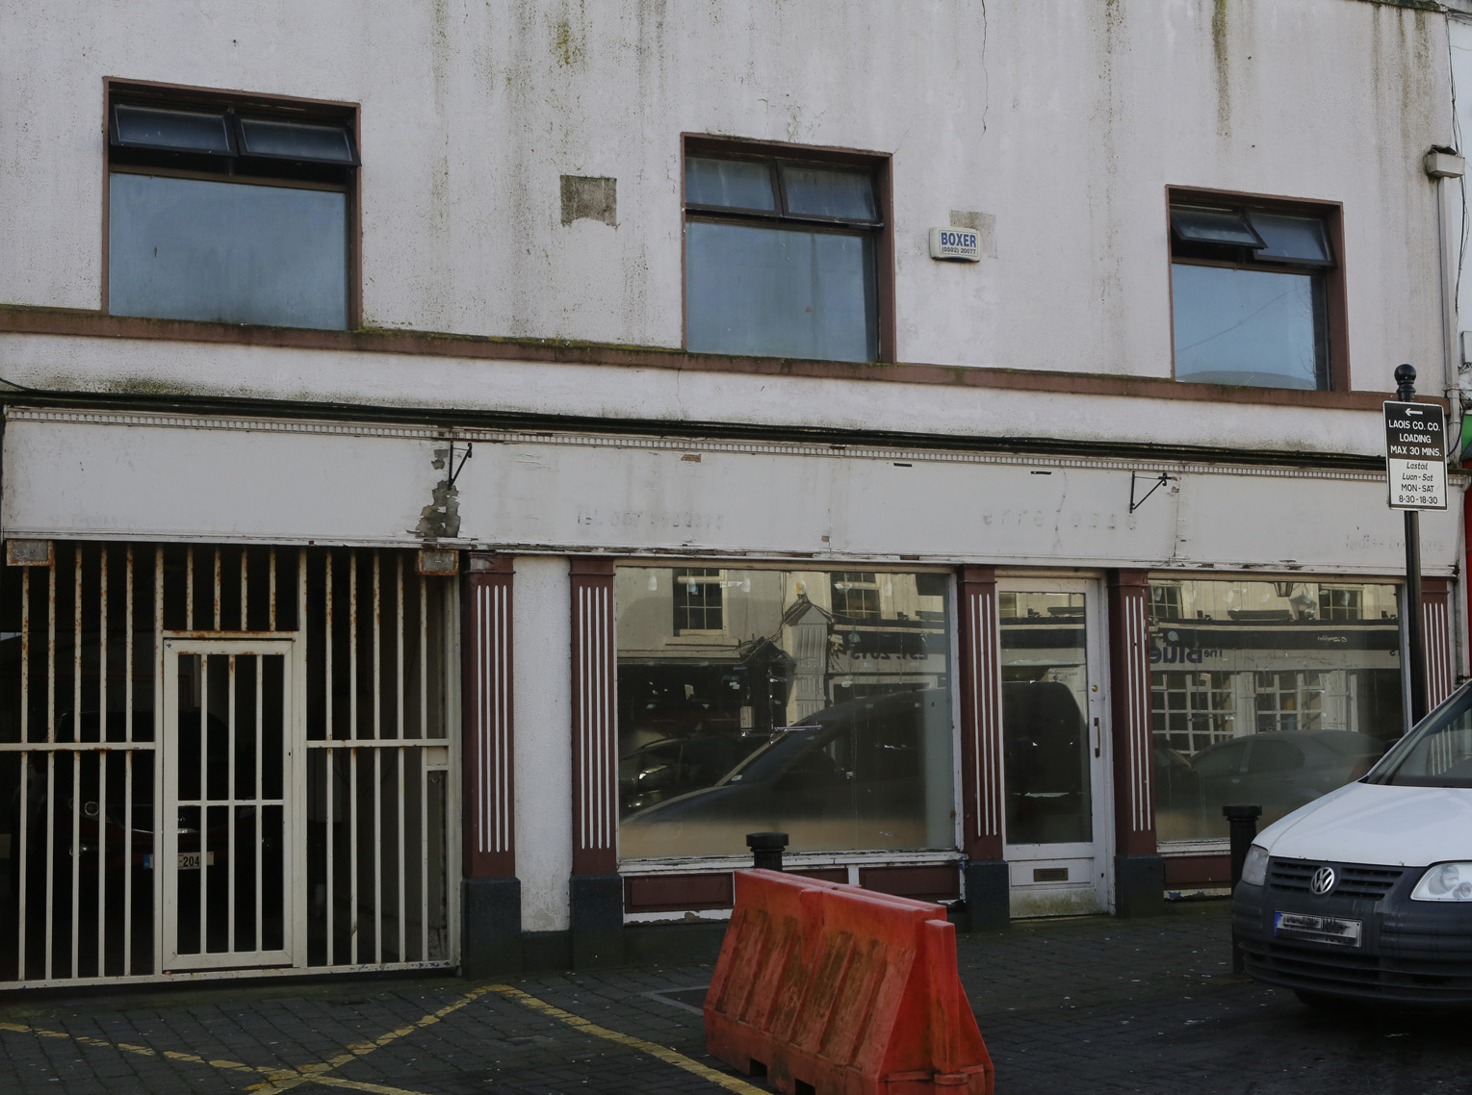
For action

Slide 4
People and Community Participation
Local consultation and engagement , participative plan making and place making
Listening
Capturing what people want to see in their own town as it expands towards a greater population
The establishment of a Town Team, town health check (energy, positivity and ownership)
Preparation of a Shared Vision and incorporation into the Statutory Local Area Plan

Slide 7
Urban Greening on JFL Avenue

Slide 8
Main elements of “A Vision for Portlaoise 2040 and Beyond”
Policies and objectives align very closely with “Ireland 2040”
The creation of a low carbon Town Centre
A walkable Town Centre (Public Realm, Accessibility
Exposure of Cultural and Built Heritage
Development of the River Triogue Blueway for amenity and safe routes to school
The connection of the Old and New Town
Provision of Accommodation and Living in the Town Centre Area
Provide for working and better business in Town Centre

Slide 9
What has been achieved so far?
Vacancy/occupancy survey completed
Designs prepared for laneway improvements
Tenders invited for new Portlaoise Library on Main Street
Heritage works on Old Fort Protector Wall and St Peters Graveyard
Purchase of vacant and derelict buildings
Progress on relocation of Courthouse to new Campus
Plans being advanced for Old Convent Site (ACA)
Plans being advanced for additional car and bicycle parking beside Portlaoise Railway Station
New Circular Relief Road proceeding to construction

Slide 10
Continued
Plans advanced for Triogue Cycle Way
Local Enterprise Office training for retail (Brexit and on-line challenges)
New Fort Protector mid summer Festival
Purchase of lands (c80 acres) at J17, Togher for Business and Employment
CPO for 3 derelict properties submitted to ABP , oral hearing has taken place and decision awaited.
Draft Plans for transformational regeneration of severely disadvantaged housing estates.
Appointment of Research Officer by LCC

Slide 11
Our view of what needs to be demonstrated
How working though and with people can bring back vitality to the Urban Core and lead to better community ownership
What a new sustainable and low carbon urban community and economy could look like,
How business and heritage can work together and are mutually beneficial
Can we entice people back to live in urban centres
How business clusters work in regional towns
Urban design and public realm, how it brings confidence to place and people

Slide 12
Continued
How to successfully repurpose existing building stock
Can we demonstrate how to combine all our relevant resources and capacity to bring cohesion to large residential estates?

Slide 13
Our Proposals for funding under the URDF are...
Confidential until Sept 28th

Slide 14
Excerpt from “A Vision for PortLaoise” a strategy for a better Town Centre
https://www.youtube.com/watch?v=CmMDbGe1YqE

